Slide 1
Blacktown Chinese Christian Church
Welcome to Our English Service 01.03.2026
English Service 9:45 – 11:00 am
Worship Songs: Passage: Speaker: Topic: Response Song: Announcements and Closing Prayer Benediction
nan Gal 2:11-14 Jose Peter Paul's Critique of Hypocrisy

Slide 2
BCCC english service

Slide 3
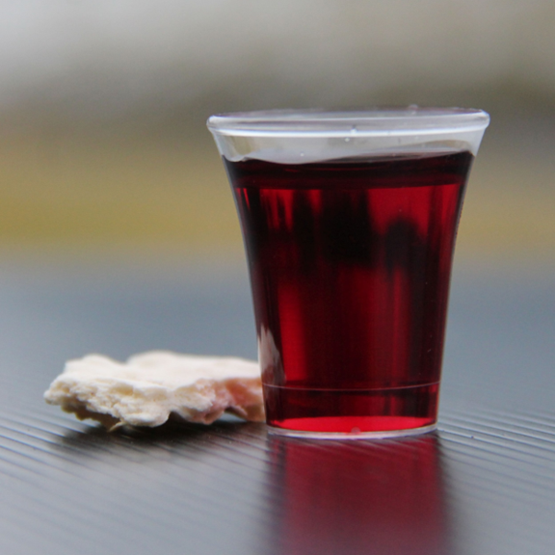
Holy Communion

Slide 4

Bible reading

Slide 5
Gal 2:11-14
¹¹ When Cephas came to Antioch, I opposed him to his face, because he stood condemned. ¹² For before certain men came from James, he used to eat with the Gentiles. But when they arrived, he began to draw back and separate himself from the Gentiles because he was afraid of those who belonged to the circumcision group.

Slide 6
Gal 2:11-14
¹³ The other Jews joined him in his hypocrisy, so that by their hypocrisy even Barnabas was led astray.
¹⁴ When I saw that they were not acting in line with the truth of the gospel, I said to Cephas in front of them all, “You are a Jew, yet you live like a Gentile and not like a Jew. How is it, then, that you force Gentiles to follow Jewish customs?

Slide 7
Announcements

Slide 8





Account name: Blacktown Chinese Christian Church
Account number: 4216 50263
Offering
BSB: 112 - 879
Please put in "offering" as the reference
The offering box is available at the back of the hall

Slide 9
Prayer points

Slide 10
Mingle time!

